Slide 1
News App Using React Native
A Modern and Responsive News App Using React.js
By Okere Chidiebube David

Slide 2
Project Overview
A responsive web app that displays live news articles.
Built using React with modern UI and state management.
Fetches news from an API (e.g., NewsAPI.org).
Allows category filtering, search, and responsive design for mobile/desktop.

Slide 3
Key Features
Live news fetching using Axios/Fetch API
Categorized news (e.g., Sports, Tech, Politics)
Search functionality
Responsive design with CSS/Bootstrap/Tailwind
Loading spinners & error handling

Slide 4
Tools & Technologies Used
Frontend: React.js, JSX, CSS/Tailwind
State Management: useState, useEffect
API: NewsAPI.org (or any API you used)
Routing: React Router (if used)
Deployment: Netlify/Vercel/GitHub Pages

Slide 5
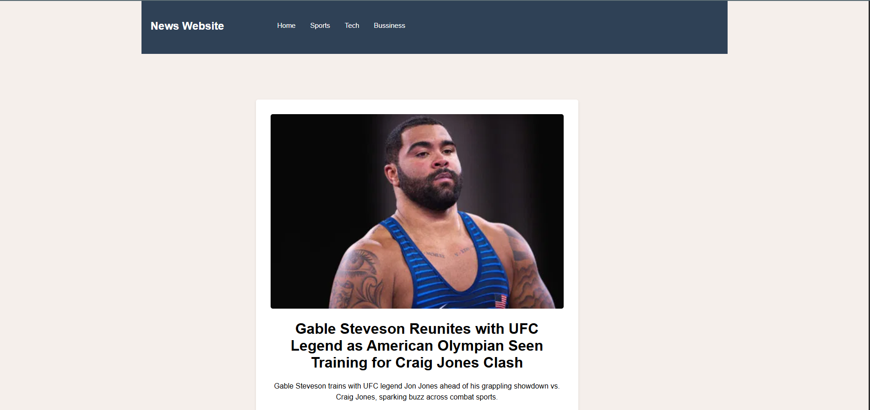
Demo Screenshots / Live Demo

